Slide 1
Business Value of Data
Freshers Program- Generic Training

Slide 2
Data for Efficiency Improvements
Support for different data types (structured, semi-structured & unstructured) has improved the efficiency of the consuming systems
RDBMS (MySQL, Oracle…etc.
Mongodb, Cassandra …etc. (JSON, XML)
Hbase, Hive…etc. (Unstructured data)
The system can quickly derive the actionable item on the data through intelligence
Driving Long term efficiency and not just instantaneous
Optimization (optimum memory & reduced delays for read and write operations)

Slide 3
Data for Business Transaction Management
Transaction is a unit of program execution that accesses and possibly updates various data items
To preserve the integrity of data the DBMS must ensure ACID Properties
Atomicity
Consistency
Isolation
Durability
DBMS should maintain different transaction states (active, failed, committed, aborted, partially committed…etc.)
It must support concurrent executions
Problems associated with transactions
Lost Update
Dirty Read
Phantom Read Record

Slide 4
Data for Enterprise Knowledge Sharing
Importance:
Enterprise Knowledge Management refers to the process of capturing the knowledge resources held within the enterprise enabling the retrieval and reuse of knowledge by individuals who are a part of the organization
Knowledge Capture, Knowledge Storage, Knowledge Sharing
Methods:
Brainstorming
Learning & Idea capture
Peer assist
Collaborative Workspace
Tools:
Knowledge base platforms
Communication platforms
Task Management platforms

Slide 5
Data for Decision Making
Actionable Intelligence : Data Driven Decision Making
Data-driven decision-making (DDDM) is defined as using facts, metrics, and data to guide strategic business decisions that align with your goals, objectives, and initiatives
Visual Analytics could help us to make the decision faster in business processes
Tools:
Tableau
Power BI
Pentaho…etc.

Slide 6
Data for Business Process Automation
Business Process Automation (BPA) is the methodology used to automate business processes to improve efficiency to reduce complexity, cost and paperwork
The data is well organized, easily searchable, and stored in databases
Steps of Business Process Automations:
Analysis
Implementation
Integration
Maintenance
What we will get?
One can create business rules easily
Visualize the results of the business process

Slide 7
File Management techniques

Slide 8
Objectives
Describe the flat files and database
Explain the advantages of using DBMS ( Database) vs flat files
DBMS
RDBMS
Summary

Slide 9
Flat files
All Data in single file which is 2 dimensional
Rows are for records and columns are for fields

Slide 10
Example of Stock flat file
Field Name | Data Type
Description | String
Cost Price | Currency
Selling Price | Currency
Number in Stock | Integer
Reorder Level | Integer
Supplier Name | String
Supplier Address | String

Slide 11
A Set / Series of Flat Files
Flat files which have at least one common field which is duplicated but not linked.

Slide 12
E.g. A Set / Series of Flat Files
File containing Stock Code, Description, Re-order level, Cost Price, Sale Price, Supplier name and address, etc
Programs to place orders when stocks are low
Purchasing Department
Programs to record orders from customers
File containing Stock Code, Description, Number sold, Sale Price, Customer name and address, etc.
Sales Department
Programs to record accounts of customers
File containing Customer name and address, amount owing, dates of orders, etc.
Accounts Department

Slide 13
Limitations of Flat Files
Which customers have bought parts produced by a particular supplier?
Find the parts supplied by a particular supplier from one file and then use a second file to find which customers have bought those parts.
Problem compounded if data is needed from more than two files.

Slide 14
Database management system
A computer program (or more typically, a number of them) designed to manage a database, a large set of structured data, and run operations on the data requested by a number of users is called Database Management System (DBMS).
A few examples of DBMS use include accounting, human resources and customer support systems.

Slide 15
Duplication of data
Supplier details duplicated if a supplier supplies more than one part.
Customer details held in two different files.
Data entered more than once, therefore time, space and money are wasted.
Loss of data integrity
What happens if a customer changes his address?
The Sales Department may update their files but the Accounts Department may not do this at the same time.
If the Order Department order some parts and there is an increase in price.
The Order Department increases the Cost and Sale prices but the Accounts Department do not, there is now a discrepancy.

Slide 16
Data dependence
If there is a need to change data formats, whole programs have to be changed.
Different applications may hold the data in different forms, again causing a problem.
If an extra field is needed in a file, all applications using that file have to be changed, even if they do not use that new item of data.

Slide 17
Incompatibility of files
If one department writes its applications in COBOL and another in C.
Departments may find it difficult to read each other’s files.

Slide 18
Fixed queries and the proliferation of application programs
Each time a new query is needed, a new program has to be written.
Difficult if the data needed to answer the query is in more than one file.
Compounded if some files are incompatible.

Slide 19
Relational Databases

Slide 20
Database management system
A computer program (or more typically, a number of them) designed to manage a database, a large set of structured data, and run operations on the data requested by a number of users is called Database Management System (DBMS).
A few examples of DBMS use include accounting, human resources and customer support systems.

Slide 21
Database Management System (DBMS)
Relational Databases use DBMS to provide a structure at three different levels:
Internal Level
Conceptual Level
External Level

Slide 22
Entities in a database
Data.
Container of data.
Application Program.
These three entities are independent.

Slide 23
Components of database system
Four components of database system are:
Data.
Software.
Hardware.
Users.

Slide 24
Why database
The three primary advantages that we get when using a database over a file system, are
Program – Data Dependency.
Rigidity.
Data Redundancy and Inconsistency.
24￼

Slide 25
Internal Level
The relational database physically stores on some form of storage medium all data in one file structure as a physical table with a data dictionary.
Physical table:
Contains all fields for all types of users (e.g. departments).
Data dictionary:
Holds information about the database necessary to enable it to work in different views for different types of users e.g. departments.
Structures of logical / virtual tables or views, Relationships, Fields (names, data types, validation, descriptions etc…).

Slide 26
Components of database system
Four components of database system are:
Data.
Software.
Hardware.
Users.
26￼

Slide 27
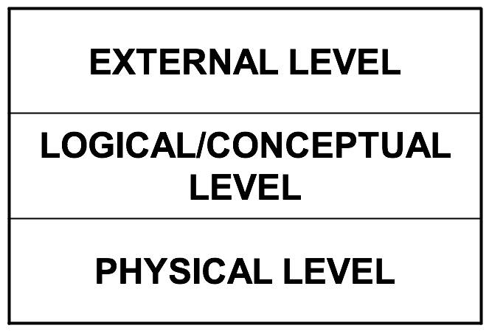
Layered database architecture
27￼

Slide 28
Features of database system
Sharing of data.
Reduction of Redundancy.
Avoidance of Inconsistency.
Maintenance of Integrity.
Enforcement of Security and Standards.
Transaction Support can be provided.
Conflicting requirements can be balanced.
28￼

Slide 29
Database users
End Users.
Application Programmers.
Database Administrators.
29￼

Slide 30
Mapping: External conceptual mapping
The logical level contains the representation of data, indirectly data would be stored in files at the physical level. External conceptual mapping is a mapping between a view at the external level with an object at the logical level.
30￼

Slide 31
Conceptual internal mapping
The mapping of objects at the logical level of the database with the files at the physical level.
31￼

Slide 32
Data independence
The separation of data from the programs that use the data.
Nearly all modern applications are based on the principle of data independence. In fact, the whole concept of a database management system (DBMS) supports the notion of data independence since it represents a system for managing data separately from the programs that use the data. In contrast, it is possible to write applications in which the data being processed is actually represented in the program's source code.
This data-dependent approach is very inflexible because it makes it difficult to modify the data and it also makes the data inaccessible to other programs.
It is the immunity of applications to change in physical representation and access technique.
32￼

Slide 33
Physical data independence
It is the capacity to change the internal schema of a database without having to change the conceptual schema.
All databases guarantee physical data independence.
Affecting physical files, in no way should affect the logical objects.
33￼

Slide 34
Logical data independence
It can be defined as the capacity to change the conceptual schema without having to change the external schema or application programs.
What happens if changes are made at the logical level of the database? Eg: Alter Table, Rename Table etc. It is brought about by setting restrictions.
The more restrictive the database, the more logical data independence will one have.
34￼

Slide 35
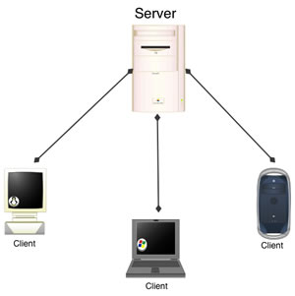
Client/server architecture
Server: It is basically the DBMS itself. It supports all the basic DBMS functions.
Clients: They are various applications run on top of DBMS.
User-written applications.
Vendor-provided applications
35￼

Slide 36

Client/server architecture (continued)
End Users
Applications
Clients
DBMS
Server
Database
36￼

Slide 37
Module 2: Objectives
After completion of this module, you should be able to:
Understand the concept of Relational Model.
Explain the importance of different keys and domains.
Identify the Relational Operators.
Understand the use of Constraints.
Understand the Codd Rules
37￼

Slide 38
Data models
Giving a description to the logical or conceptual level.
It is the representation of data in a database at the logical level.
38￼

Slide 39
Data models (continued)
Data Models
Record Based
Data Model
Physical Data
Model
Object Data
Model
Relational Model
Hierarchical Model
Network Model
39￼

Slide 40
Relational database
The important features are:
Name of the object at the logical level.
Structure of the logical level object.
40￼

Slide 41
Relationship mapping
domain
range
1:many
many:1
1:1
many:many
41￼

Slide 42
Relationship model
No duplicate tuples should be there in a relation.
Ordering of tuples is not necessary.
Attributes of a relation have an implied ordering
The attribute values of a tuple must be within the domain of the relation or a special value NULL must be present.
The attribute values and domain values must be atomic.
42￼

Slide 43
Comparative Terms
Terms
Oracle
Relation schema
Table description
Relation
Table
Tuple
Row
Attribute
Column
Domain
Value set
Notation Employee (emp_id,emp_name,sal) Student (studno,name,class) Department (Dept_no,Dept_name)
43￼

Slide 44
Keys
Candidate Key.
Primary Key.
Super key.
Foreign Key.
Alternate Key.
44￼

Slide 45
Key definitions
Candidate Key: There may be a number of attributes or a combination of attributes which uniquely identify each instance of an entity. These are known as candidate keys.
Primary Key: An attribute whose value can uniquely identify a complete record (one row of data) within an entity.
Super key: If additional attributes are added to the primary key, the resulting combination would still uniquely identify an instance of the entity set. These augmented keys are called super keys.
Composite Primary Key: A primary key that consists of two or more attribute within an entity.
45￼

Slide 46
Key definitions (continued)
Foreign Key: A copy of a primary key that exists in another entity (may exist in the same entity too) for the purpose of forming a relationship between the entities involved. (Discussed in detail later.)
Alternate Key: The primary key is selected from the set of candidate keys. The remaining candidate keys are the alternate keys.
46￼

Slide 47
Foreign key
a set of attributes in a relation that exactly matches a (primary) key in another relation
the names of the attributes don’t have to be the same but must be of the same domain
a foreign key in a relation A matching a primary key in a relation B represents a
many: one relationship between A and B
Employee (Emp_id, Emp_name, Sal, Dept_id)
Department (Dept_id, Dept_name)
47￼

Slide 48
Referential integrity
Cascade: delete all matching foreign key tuples. Deletes those tuples matching in employee table.
Restrict: can’t delete primary key tuple Department whilst a foreign key tuple Employee matches
Nullify: foreign key Employee.Dept_id set to null if the primary key Dept_ids are deleted.
48￼

Slide 49
Entity integrity and nulls
No part of a key can be null
Attribute values
Atomic
Known domain
Sometimes can be null
THREE categories of null values
Not applicable
Not known
Absent (not recorded)
49￼

Slide 50
Attribute constraints
This constraint is basically the declaration that a specified attribute is of specified type, the maximum value, minimum value, length of the field associated with them.
Example:
Emp Relation
{ Emp_no Integer(5)
Emp_name Char(20)
}
50￼

Slide 51
Database constraints (Oracle)
Not Null.
Check.
Primary Key.
Foreign Key.
Unique.
51￼

Slide 52
Relational Operators
Restrict orSelect: Only specific tuples from a relation satisfying a specific condition is returned.
Project: All tuples in a specified relation and only specified attributes are returned.
Product: It returns a relation containing all possible tuples that are a combination of two tuples, one from each of two specified relations.
Union: All tuples appearing in either or both of two specified relations are returned.
Intersect: All tuples appearing in both of two specified relations are returned.
Difference: All tuples appearing in the first and not the second of two specified relations are returned.
Join: All tuples that are a combination of two tuples, one from each of two specified relations, such that the two tuples contributing to any given combination have a common value for the common attributes of the two relations.
52￼

Slide 53
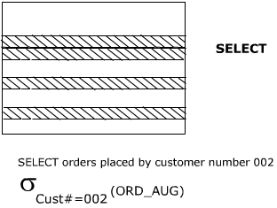
Select
To retrieve specific tuples/rows from a relation
Ord# | OrdDate | Cust#
101 | 02-08-94 | 002
104 | 18-09-94 | 002
53￼
Core Java | IBM Internal Use | Day 1 | 16-Jun-09

Slide 54
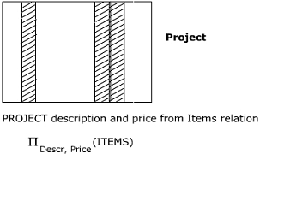
Project
To retrieve specific attributes/columns from a relation.
Descr | Price
Power Supply | 4000
101-Keyboard | 2000
Mouse | 800
MS-DOS 6.0 | 5000
MS-Word 6.0 | 8000
54￼
Core Java | IBM Internal Use | Day 1 | 16-Jun-09

Slide 55
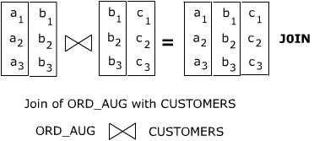
Join
Example:
ORD_AUG join CUSTOMERS (here, the common column is Cust#)
Ord# | OrdDate | Cust# | CustNames | City
101 | 02-08-94 | 002 | Srinivasan | Madras
102 | 11-08-94 | 003 | Gupta | Delhi
103 | 21-08-94 | 003 | Gupta | Delhi
104 | 28-08-94 | 002 | Srinivasan | Madras
105 | 30-08-94 | 005 | Apte | Bombay
55￼
Core Java | IBM Internal Use | Day 1 | 16-Jun-09

Slide 56
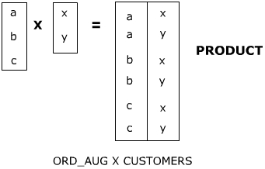
Product
To obtain all possible combination of tuples from two relations.
Ord# | OrdDate | O.Cust# | C.Cust# | CustName | City
101 | 02-08-94 | 002 | 001 | Shah | Bombay
101 | 02-08-94 | 002 | 002 | Srinivasan | Madras
101 | 02-08-94 | 002 | 003 | Gupta | Delhi
101 | 02-08-94 | 002 | 004 | Banerjee | Calcutta
101 | 02-08-94 | 002 | 005 | Apte | Bombay
102 | 11-08-94 | 003 | 001 | Shah | Bombay
102 | 11-08-94 | 003 | 002 | Srinivasan | Madras
56￼
Core Java | IBM Internal Use | Day 1 | 16-Jun-09

Slide 57
Tables
These are the reference tables on which the next operations will be performed.
Emp_no | E_Name
1 | Jones
3 | Smith
4 | Lalonde
7 | Evan
10 | Drew
12 | Smith
Emp_no | E_Name
3 | Smith
4 | Lalonde
6 | Byron
10 | Drew
57￼
Core Java | IBM Internal Use | Day 1 | 16-Jun-09

Slide 58
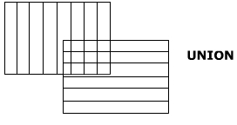
Union
To retrieve tuples appearing in either or both the relations participating in the UNION.
Emp_no | E_name
1 | Jones
3 | Smith
4 | Lalonde
6 | Byron
7 | Evan
10 | Drew
12 | Smith
AUB
58￼
Core Java | IBM Internal Use | Day 1 | 16-Jun-09

Slide 59
Intersect
To retrieve tuples present in both the relations participating in the intersect.
INTERSECT
Emp_no | E_name
3 | Smith
4 | Lalonde
10 | Drew
A∩B
59￼
Core Java | IBM Internal Use | Day 1 | 16-Jun-09

Slide 60
Difference
To retrieve tuples appearing in the first relation participating in the DIFFERENCE but not the second.
Emp_no | E_name
1 | Jones
7 | Evan
12 | Smith
DIFFERENCE
A-B
60￼
Core Java | IBM Internal Use | Day 1 | 16-Jun-09

Slide 61
Summary
Thus we understand the concept of RDBMS, the different kinds of constraints setting different types of integrity.
We also come to know about a number of operators performing different operations on relations.
The different types of keys and their significance.
We can say that RDBMS with its advantages and easy use have appealed the mass who are gradually moving away from the file handling systems.
61￼

Slide 62
Summary
We can conclude by saying that the basic purpose of Entity Relationship Model is to decide:
The table name and structure
The column names
The attributes
How will the tables be related to one another.

Slide 63
What is a Data Federation?
A computer program (or more typically, a number of them) designed to manage a database, a large set of structured data, and run operations on the data requested by a number of users is called Database Management System (DBMS).
A few examples of DBMS use include accounting, human resources and customer support systems.

Slide 64
What is Data Federation
A data federation is a software process that allows multiple databases to function as one. This virtual database takes data from a range of sources and converts them all to a common model. This provides a single source of data for front-end applications.
Data Federation in Business
One of the biggest challenges facing businesses today is managing data effectively. There can be multiple problems with data:
Multiple cloud databases and different sites restricts access
Large volumes of data need massive storage
No consistency among data, requiring effort and time to cleanse and organize
No single format of how or where data is stored

Slide 65
Data virtualization
is an umbrella term used to describe an approach to data management that allows an application to retrieve and manipulate data without requiring technical details about the data, such as how the data is formatted or where it is physically located. The goal of data virtualization is to create a single representation of data from multiple, disparate sources without having to copy or move the data.

Slide 66
Data In the cloud
Cloud storage is a cloud computing model that stores data on the Internet through a cloud computing provider who manages and operates data storage as a service. It's delivered on demand with just-in-time capacity and costs, and eliminates buying and managing your own data storage infrastructure.
The Data Cloud allows organisations to unify and connect to a single copy of all of their data with ease. The result is an ecosystem of thousands of businesses and organisations connecting to not only their own data, but also connecting to each other by effortlessly sharing and consuming shared data and data services.
The Data Cloud makes the vast and growing quantities of valuable data connected, accessible, and available.

Slide 67
Data Stream
Streaming data is data that is generated continuously by thousands of data sources, which typically send in the data records simultaneously, and in small sizes (order of Kilobytes). Streaming data includes a wide variety of data such as log files generated by customers using your mobile or web applications, ecommerce purchases, in-game player activity, information from social networks, financial trading floors, or geospatial services, and telemetry from connected devices or instrumentation in data centers.

Slide 68
Data management techniques

Slide 69
What are we going to learn?
Managing data at rest & data in transit
Transaction systems and Analytical systems
Why cant we use a transaction system for large scale analysis? Need of a separate analytical system when we capture data at an enterprise level
Why constant monitoring and security becomes crucial?

Slide 70
Transaction systems and Analytical systems
Transaction systems
Quick turn around time
Low latency in the n/w
Consistency
Handle large user base (through put)
Low number of records getting affected
Availability
Resilience
Transaction oriented
Analytical systems
Can compromise on turn around time
N/w latency is not an issue as it happens in one place
Consistency
Batch processes are triggered by a single user
Very large number of records are getting affected/ used
Processes can be restarted even after failure, not critical for business continuity
Analysis oriented

Slide 71

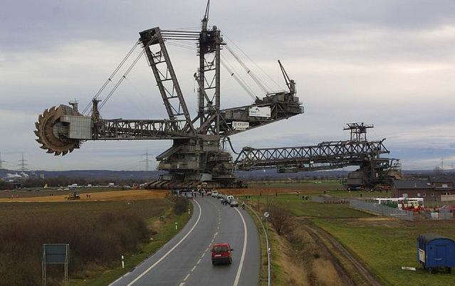

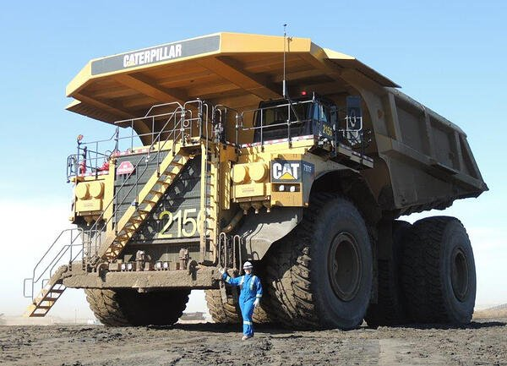

Slide 72
Why do we need a separate system for doing analysis?
What is Business continuity?
Computation power/ processing capability of a system
What will happen if we share the computation power between transaction processes and analytical processes?
The way data is stored in transaction system is ideal for transactions not bulk analysis
Internal system designs – row based storages and columnar storages
Integrate data in silos – bring data to the same platform for analysis
We need a separate system to do the analysis on large amount of data, whose storage and computation is designed for that purpose

Slide 73
We need to bring data from Txn system(s) to a single platform
Transaction system(s) will be working in their silos
We need to bring the data to a single platform to do the analysis
Data Integration
Understand the sources and pull data from them to our platform
Design/ define & implement business rules to BLEND them
Create an ideal storage mechanism for the processed data and push the output to the same (typically a DWH)
Pull → Process → Push : Extract → Transform → Load
ETL tools, ETL server

Slide 74
Serve the data to its stake holders
There are multiple ways in which the stake holders can consume/ need data
Sometimes stake holder will be having an automated process to consume data from DWH
We, as the DWH owner, might not be interested in sharing the tables as is
We can go by sharing the subset of DWH
Data Mart
We can share the data via APIs
We can serve data in OLAP cubes (SSAS/ AAS) for Visualization/ BI engineers
We can serve data via in-memory systems like presto or caches – this is also referred as semantic layer

Slide 75
Key take away in data integration
Understand the sources – Source profiling
Design the rules to process data – Mapping and transformation
Design/ implement the way the processed data to be stored
Find a proper storage mechanism
Design the storage – file storage/ lake storage/ DWH (data modeling)
Design of storage should take care of the consumers/ the stake holders
Design of semantic layer
Do we need additional tools for the same?
Do we need to show all the data or just the subset?
Do we need to create additional tools, like APIs

Slide 76
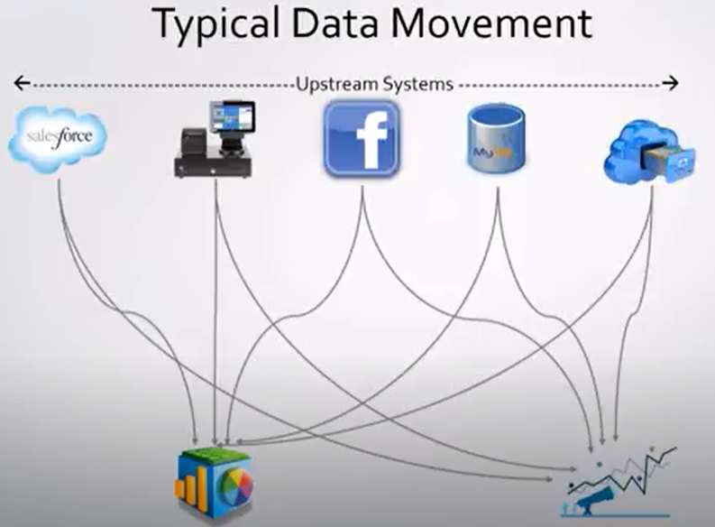
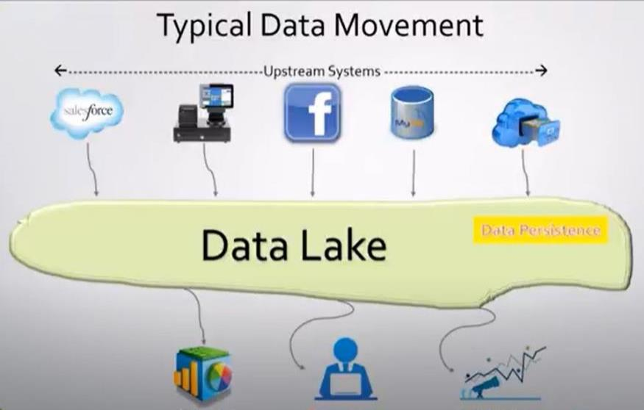
Complexities involved in Ingestion
Data ingestion from multiple sources can bring in complexities
In order to handle them we may need to make changes in our Data Integration tool (ETL)
When the number of sources increases these changes can bring in a lot of complexities

Slide 77
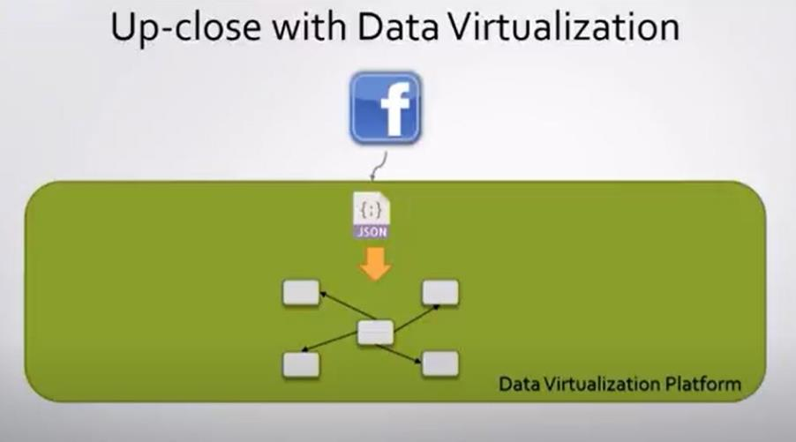
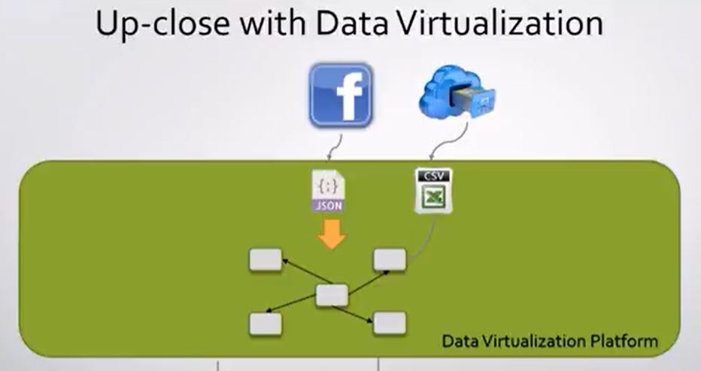
Hides the complexities due to multiple end points from upstream systems
Abstraction layer providing a buffer from sudden changes to the upstream systems
Near real-time data. We are not storing data (or store recent data i.e a cache)

Slide 78
Can I find something meaningful from my data?
How can I find something meaningful from my data
Get the data
As of now we don’t know the capabilities of the data in our hand
As a first step we do Exploratory Data Analysis
Discuss with business on the results
We start doing statistical analysis of the data
As statistical analysis is a compute intensive process, we need to take help from the ML algorithms
Data mining is the process of extracting and discovering patterns in large data sets involving methods at the intersection of machine learning, statistics, and database systems.

Slide 79

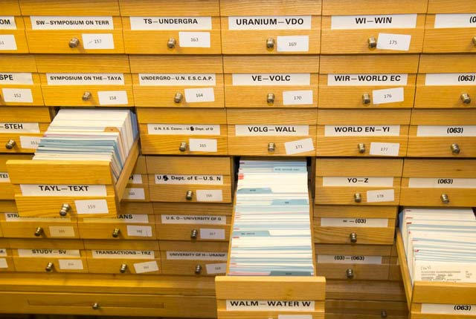
Its better to keep things arranged

Slide 80
Do we need to arrange data also?
Yes yes yes & yes
We need to retrieve it for the consumption layer or further analysis
How do we Data cataloguing?
Custom tools
Products

Slide 81
Data Lakes
Lots n lots of data – batch, transactions, streams, social media, ad…..
Data lake is not (ONLY) a storage, it’s a methodology of storing data
Ingestion framework
Storage (typically distributed)
Govern
Apply the insights
Govern
Ingest
Apply
Store
Data Prep
Feature extraction,
Imputations
ML training

Slide 82
How secure is our data
Consider data at rest and data in transit
Encryption in place to encrypt the data in any storage
There are security protocols and encryptions to make the data in transit secure
Availability
Reliability
Consistency
Resilience of storage
Scalability
Monitoring systems on azure ecosystem

Slide 83
Business Enterprise Data Initiatives

Slide 84

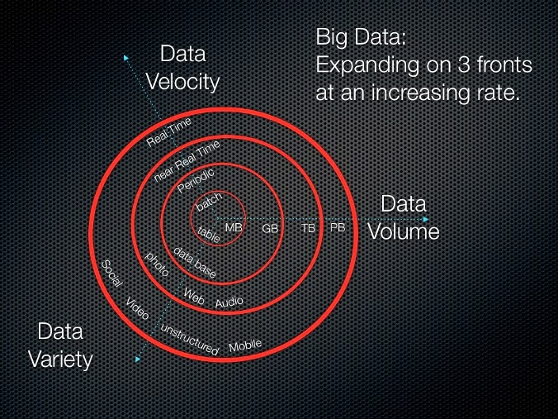
What is Big Data?
Used to describe large collections of data sets that can be unstructured and growing so large that can be difficult to manage by traditional databases.

Slide 85
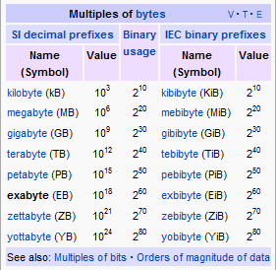
Measures of Data Volume

Slide 86
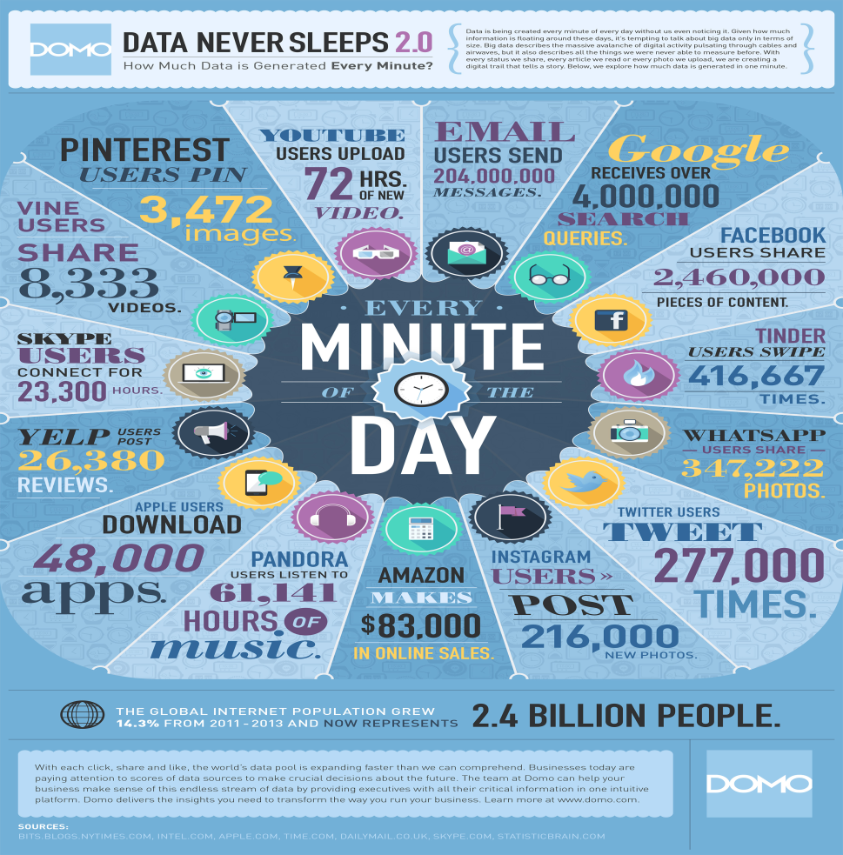
How much Data is generated?
Google processes 1000’s of PB/day, 48 hours of video uploaded every minute
Facebook has 100 PB and collects 500 TB/day
http://gigaom.com/data/facebook-is-collecting-your-data-500-terabytes-a-day/
eBay has 10 PB of user data + 100 TB/day
http://www.zdnet.com/au/how-ebay-uses-big-data-to-make-you-buy-more-7000006498/
CERN’s Large Hadron Collider (LHC) generates 25 PB a year

Slide 87
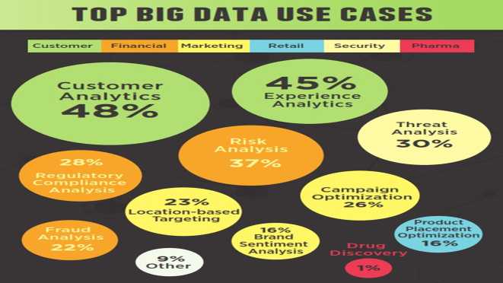

Slide 88
How Big data is used?
Diagnosis
Why are customers not paying bills?
Why is system slow
Detect anomalies, viruses, spam, worms etc.
Decision
Decide marketing strategies
Make better financial and customer centric decisions
Block viruses, worms and spam

Slide 89
Hadoop is the Savior!
HDFS
Hadoop is Opensource and hence no license required unlike RDBMS
HDFS is distributed and hence fault tolerant
Cheap commodity hardware works good
Map reduce
Parallel processing and hence faster
Written in Java
Distributed parallel algorithm

Slide 90
Introduction to
Data Analytics

Slide 91
Life cycle of a Data Science project
Problem Definition
Data Collection & cleaning
Data Exploration
Data Preparation
Advanced Analytics
Solution Development

Slide 92
Exploratory Data Analysis

Slide 93
Data Summary
In descriptive statistics, summary statistics are used to summarize a set of observations, in order to communicate the largest amount of information as simply as possible.
Numerical attributes are described using the properties:
Min
25th percentile
Median
Mean
75th percentile
Max
The breakdown also includes an indication of the number of missing values for an attribute (marked N/A).

Slide 94
Visualization

Slide 95
Visualize Your Data
Visualization means creating charts and plots from the raw data.
Plots of the distribution or spread of attributes can help you spot outliers, strange or invalid data and give you an idea of possible data transformations you could apply.
Visualization Packages: A quick note about your options when it comes to R packages for visualization.
Univariate Visualization: Plots you can use to understand each attribute standalone.
Multivariate Visualization: Plots that can help you to better understand the interactions between attributes.

Slide 96
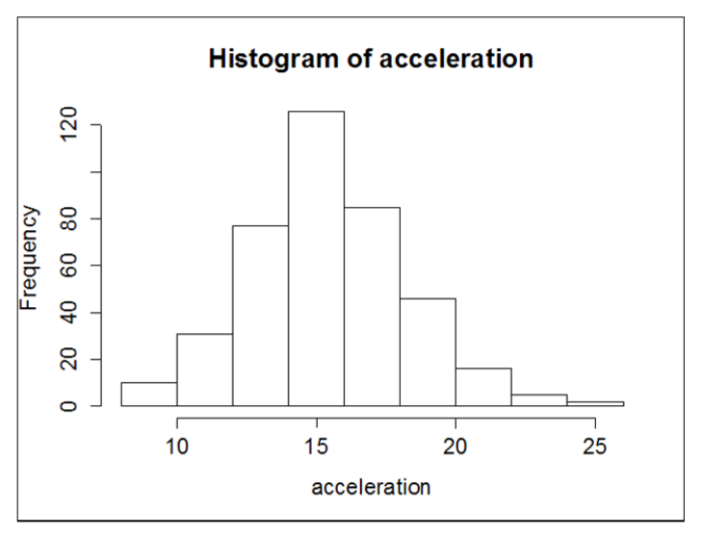
Histogram
hist(acceleration)
R determines the various properties of the generated graph (like bin sizes, axes scales, axes titles, chart title, bar colors,…) automatically. The following diagram shows the output of the preceding command:

Slide 97
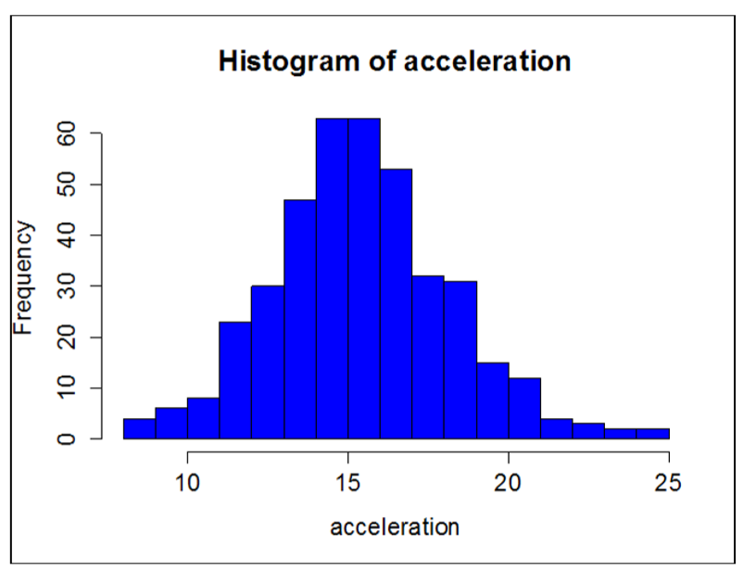
Histogram
hist(acceleration, col="blue", xlab = "acceleration", main = "Histogram of acceleration", breaks = 15)

Slide 98
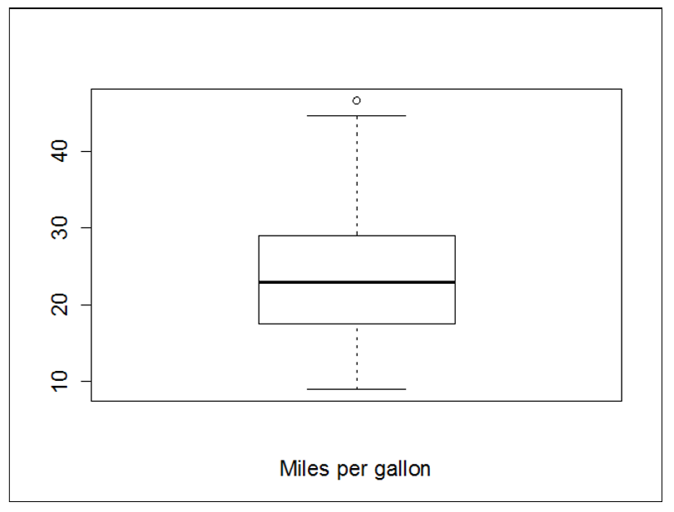
Boxplots
boxplot(mpg, xlab = "Miles per gallon")

Slide 99
Boxplots
boxplot(mpg, xlab = "Miles per gallon")

Slide 100
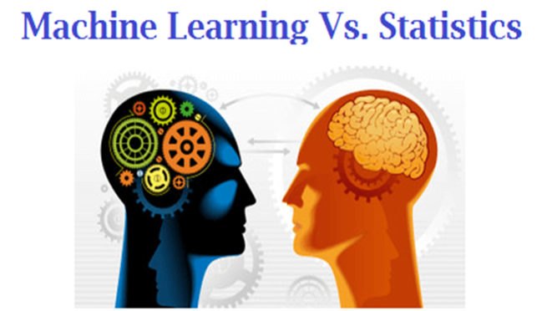

Slide 101
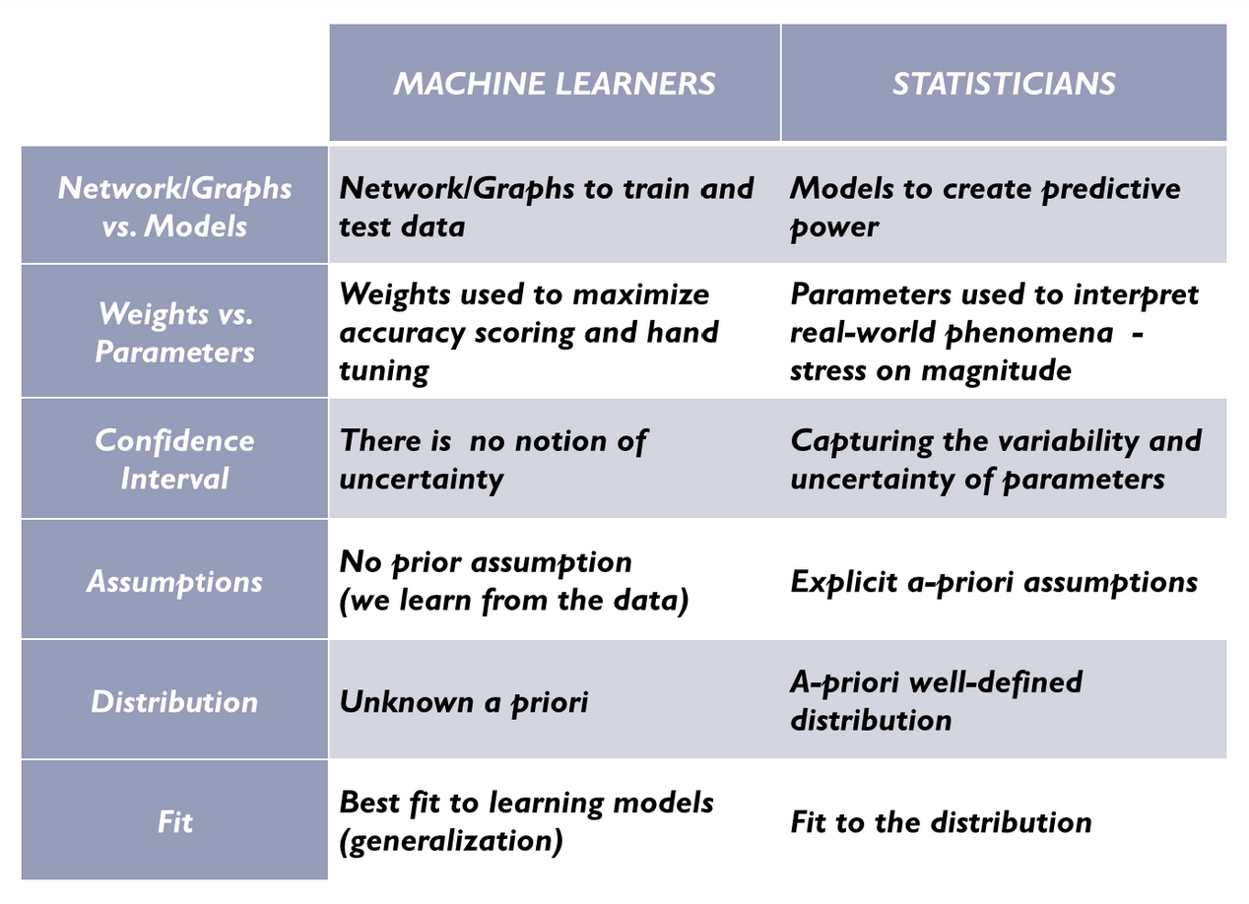
ML vs Statistics

Slide 102
Feature Selection

Slide 103
Common Data Problems
Noise: random error or variance in a measured variable
Extremely high quantity, rate and amount were eliminated from the data.
Negative discount values were eliminated from the data.
Missing data may be due to
Equipment malfunction
Consistent with other recorded data and thus deleted
Data not entered due to misunderstanding
Certain data may not be considered important at the time of entry
Not register history or changes of the data
Unified date format:
binary, nominal (categorical), ordinal, numeric
e.g. “Sep 24, 2003” , 9/24/03, 24.09.03, etc
Containing discrepancies in names
Other data problems which requires data cleaning
Duplicate records
Incomplete data
Inconsistent data

Slide 104
Understand Your Data Using Descriptive Statistics
Any machine learning models that you build are only as good as the data that you provide them. The ﬁrst step in understanding your data is to actually look at some raw values and calculate some basic statistics.
Data Cleaning : You may discover missing or corrupt data and think of various data cleaning operations to perform such as marking or removing bad data and imputing missing data.
Data Transforms : You may discover that some attributes have familiar distributions such as Gaussian or exponential giving you ideas of scaling or other transforms you could apply.
Data Modeling : You may notice properties of the data such as distributions or data types that suggest the use (or to not use) speciﬁc machine learning algorithms.

Slide 105
Feature Selection
Feature selection is also called variable selection or attribute selection.
It is the automatic selection of attributes in your data (such as columns in tabular data) that are most relevant to the predictive modeling problem you are working on.
Feature Selection Algorithms
Filter Methods
Some examples of some filter methods include the Chi squared test, information gain and correlation coefficient scores.
Wrapper Methods
A predictive model us used to evaluate a combination of features and assign a score based on model accuracy.
Embedded Methods
Examples of regularization algorithms are the LASSO, Elastic Net and Ridge Regression.

Slide 106
Thank You

